Slide 1


Machine Learning
With python
TREE1: tree-based algorithms
decision boundaries, gini + entropy (WS)
Notes:
Layout objects pulled from: https://slidesgo.com/
All icons are from: https://thenounproject.com/

Slide 2



Datasets This Week
Datasets This Week
HW
Lab
Wisconsin
Breast Cancer
link: kaggle
Titanic
link: github

Slide 3

warmup
Get into groups of 3-4 and have one person think of something smaller than a loaf of bread.
The other people have up to 20 tries to ask questions that must give yes/no responses to find out what the first person thought of.
Question 1: is it smaller than a loaf of bread?
no yes
Question 2: is it XXX?
no yes

Slide 4
ML Approaches
Algorithm Types
Classification
goal is categorical, discrete
Supervised Learning
targets given
Regression
goal is number, continuous
Unsupervised
Learning
targets not given, only features
Clustering
goal is finding patterns, or labeling data for use in supervised learning
algs: k-means, hierarchical, GMMs

Slide 5
Model Types
Algorithm Types
Tree-based
segment feature space into simple regions and then make prediction based on which region a new record falls into
Classification
goal is categorical, discrete
Regression
goal is number, continuous
Linear
detect linear relationships among features and then make prediction on a response variable with infinite possibilities
Both tree and linear models have both classification and regression algorithms!

Slide 6
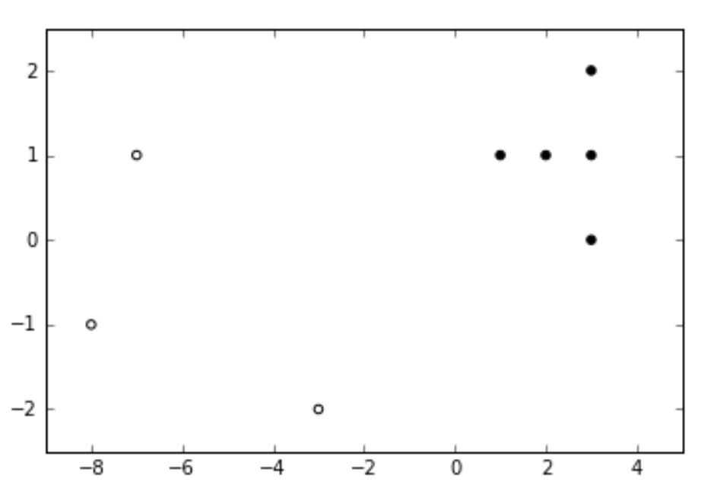
Decision Trees
essentially play 20Q
ask enough yes/no questions until we can make a prediction
Big Idea: pick the right questions to separate the classes
Simple Example
which question would split our feature space so that all open circles and all closed circles are in their own regions?
is x < -2?

Slide 7
Simple Example
which question would split our feature space so that all open circles and all closed circles are in their own regions?
Simple Decision Tree Diagram
Write down our first question “is x<-2”. This is our initial node. Now draw two boxes below this, one labeled open and one labeled closed. Connect our initial node to each label with either a yes or no arrow.
is x < -2?
no yes
is x < -2?
closed
open

Slide 8
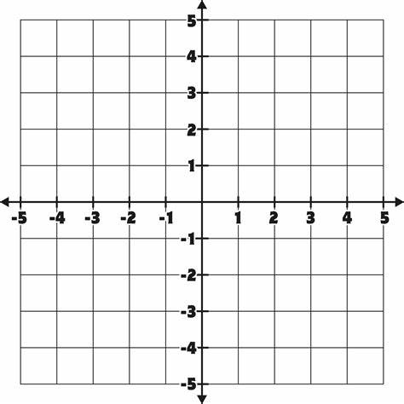
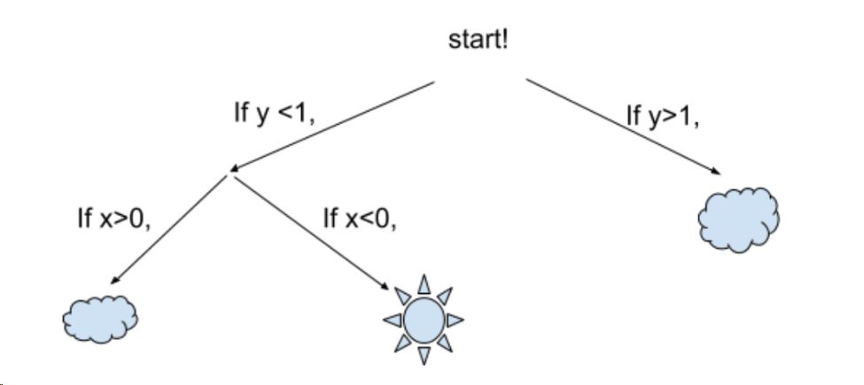
Exercise
Grab a partner and a whiteboard marker. Based on the decision tree below, shade in the set of points (x, y) that would be classified as cloudy
y > 1 → cloudy
x > 0 → cloudy

Slide 9
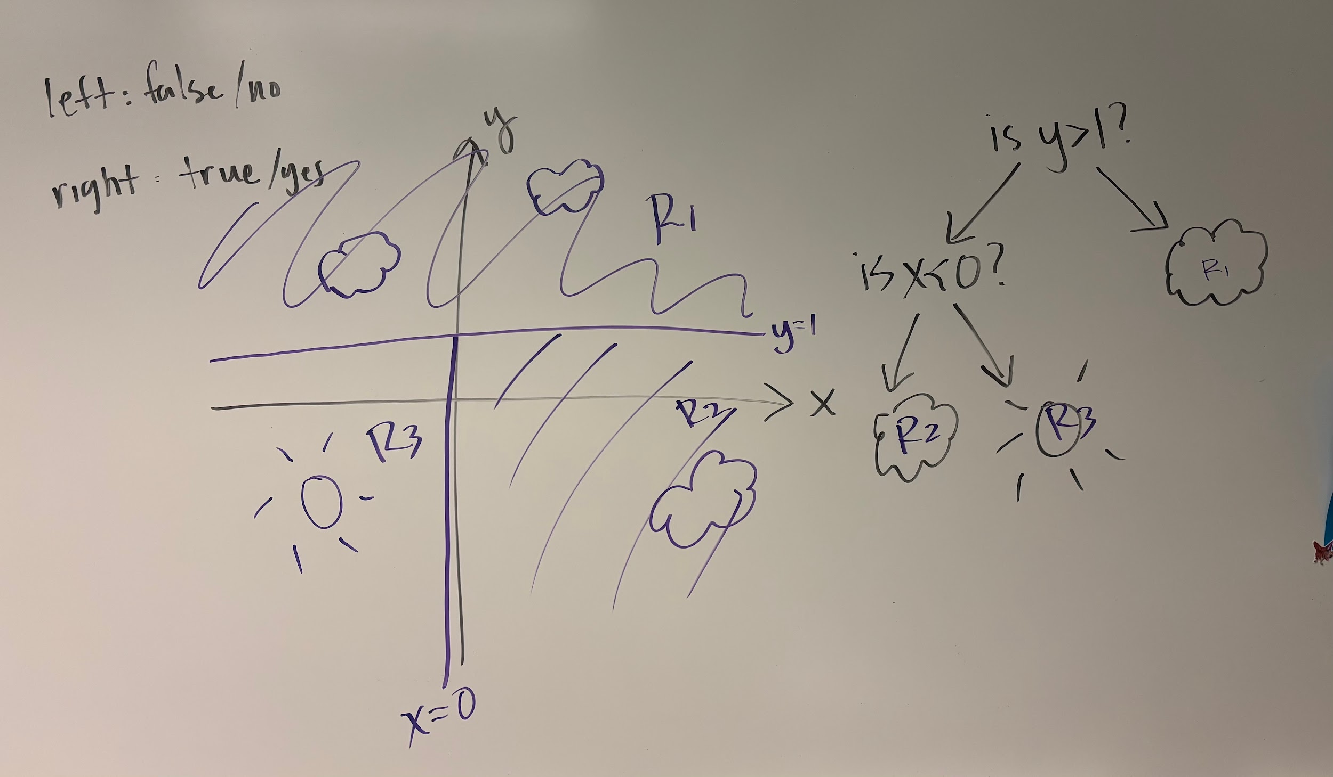
Picture of whiteboard from example exercise

Slide 10
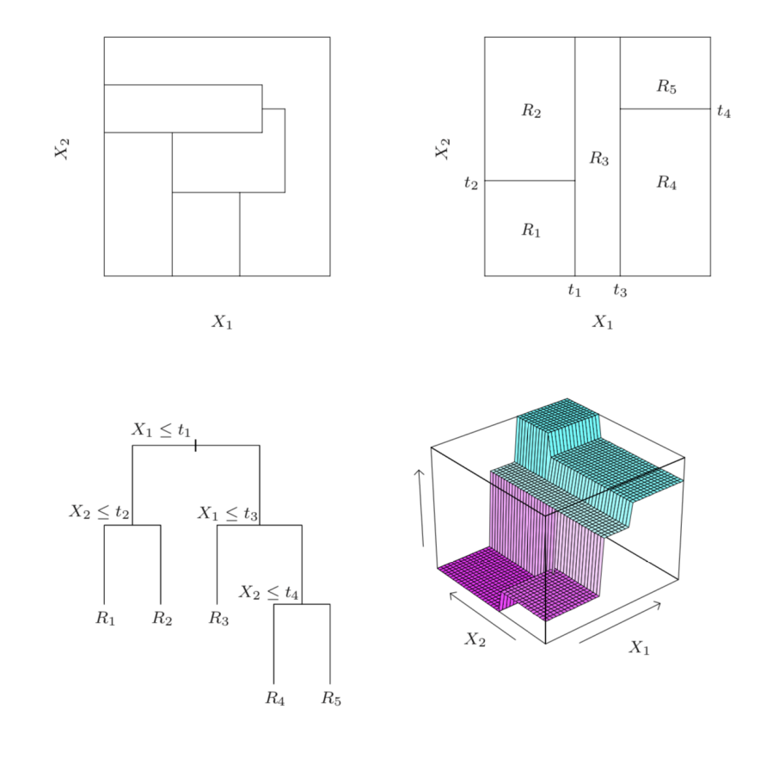
Decision Tree Algorithm
Begin at the root node, with the set of data points R. If all data points in R have the same class, end.
For each attribute, compute how much splitting on it would reduce uncertainty (based on chosen measure)
Split on attribute that reduce uncertainty the most, partitioning R into Ri and Rj
Create two branches from the root, and recursively call (i.e. go back to step 1) the decision tree algorithm for each branch (i.e. replace R with subsets Ri and Rj) and repeat until all data points in subsets have same class.
Figure from ISL 8.1
Top left: regions that cannot be represented by a tree
Top right: regions that can be represented by a tree
Bottom left: tree generating the top right regions
Bottom right: function values assigned to the regions

Slide 11
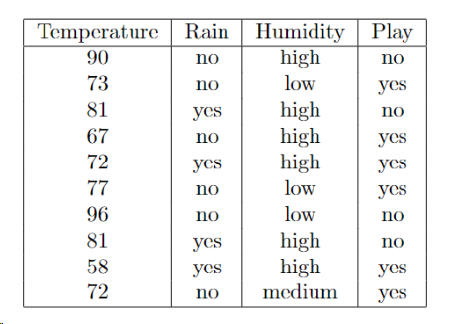
Exercise
you are trying to figure out if a soccer game will happen today and last year you recorded the information in the table below:
1. For Saturday, the forecast is 90 degrees, high humidity, and no rain. Do you think a game will occur?
2. For Sunday, the forecast is 70 degrees, low humidity, and rain. Do you think a game will occur?
3. Draw a decision tree that tells you if a game will happen based on the weather
When finished, continue working on this worksheet
No
is temp > 80?
Yes
yes no
don’t play
play

Slide 12
How does the decision tree algorithm decide what questions to ask in the tree?
Key Idea: At each split, use the question that reduces uncertainty the most
is temp > 80?
Our goal is to find the feature that explains the most uncertainty / chaos / disorder / variability within our feature space since splitting on this variable will create the most ordered space possible
yes no
don’t play
play

Slide 13
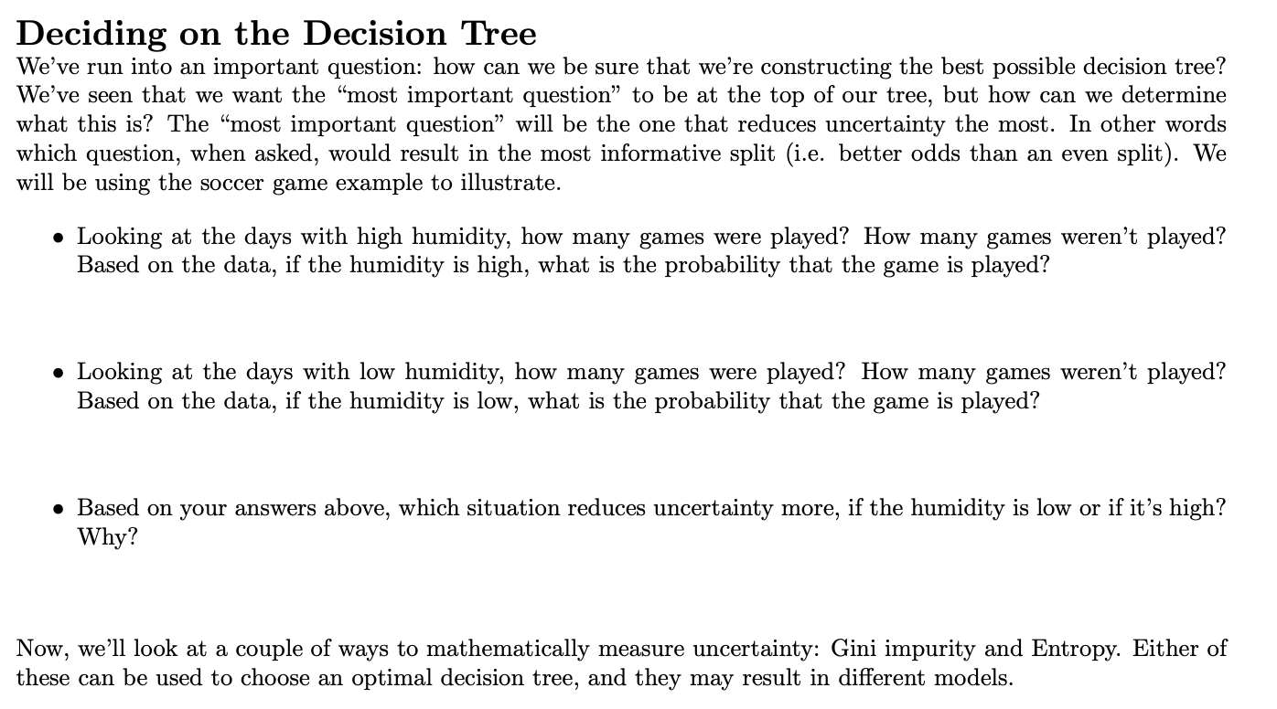
6 days high humidity: 3 yes, 3 no → P(yes and high humidity) = 3/6
3 days low humidity: 2 yes, 1 no → P(yes and low humidity) = 2/3
low humidity since 2/3 > 3/6

Slide 14


The two ways to mathematically measure uncertainty are the Gini impurity and entropy. Suppose the probability of an event happening is p, and the probability of the same event not happening is 1-p.
Then the Gini impurity in this situation is
The entropy in this situation is
Both Gini impurity and entropy are between 0 and 1, with larger values corresponding to greater uncertainty. Values closer to zero mean there is less uncertainty, so our guesses are more accurate.

Slide 15
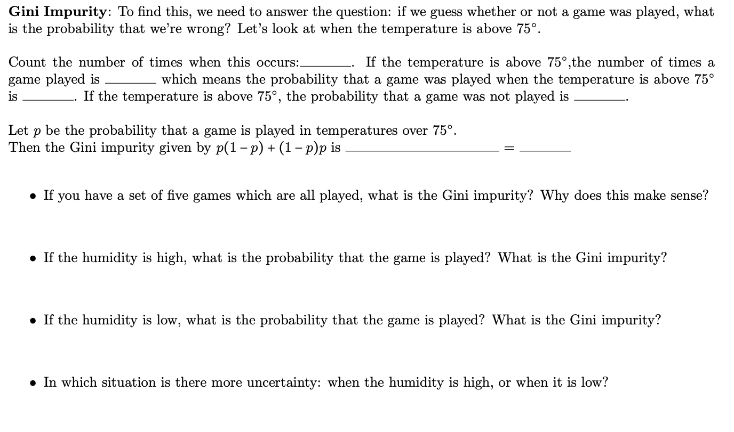
5
1
1/5
4/5
1/5(4/5) + 4/5(1/5)
8/25
same as 1/5(4/5) *2 or p(1-p)*2
p = 1 → 0(1) + 1(0) = 0 → you play all games so no uncertainty
P(high humidity and yes) = 3/6 or 1/2 → 1/2(1/2) *2= 1/2
P(low humidity and yes) = 2/3 → 2/3(1/3) *2= 4/9
more uncertainty when humidity is high since larger impurity → 4/9 < 1/2

Slide 16

Exercise
If the humidity is not high (so it’s either low or medium), what is the probability that the game is played? What is the Gini impurity?
If the humidity is not low (so it’s either medium or high), what is the probability that the game is played? What is the Gini impurity?
In which situation is there more uncertainty: when the humidity is not high, or when it is not low?

Slide 17
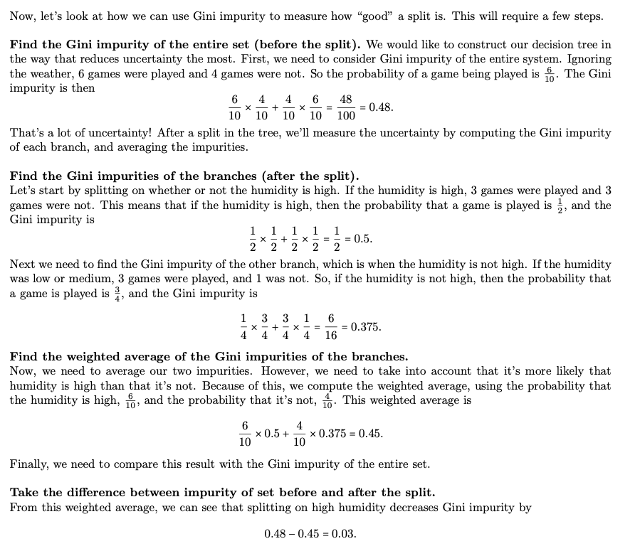
The worksheet walks you through a specific example of how to measure a good split.
The next slide will walk through how to generalize this particular process.
page 3

Slide 18
Let’s say we have a question (called Q or feature) we want to consider as a feature split. In the soccer example this could be “is it high humidity” or “is temp > 80?”.
Step1: Compute total uncertainty that exists in the data as-is using chosen measure:
Impurity TOTAL = P(TARGET=YES) * P(TARGET=NO) * 2
Step2: Compute weighted average uncertainty for each feature question using chosen measure:
Impurity Q = P(Q=YES)* Impurity Q=YES + P(Q=NO)* Impurity Q=NO
where Impurity Q=YES = P(TARGET=YES & Q=YES ) * P(TARGET=NO & Q=YES) * 2 .
and Impurity Q=NO = P(TARGET=YES & Q=NO ) * P(TARGET=NO & Q=NO) * 2 .
Step3: the step 2 uncertainty that decreases step 1 uncertainty the most is the feature question that splits the data!
max( Impurity TOTAL - Impurity Q )
Step 1
Step 2

Slide 19
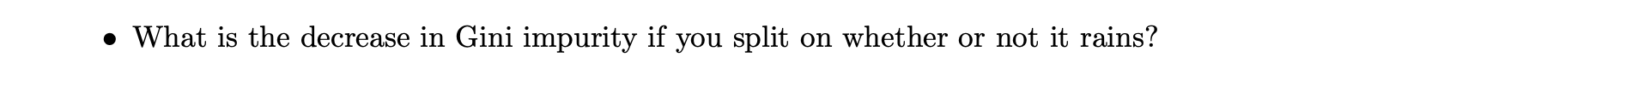
Q: is it raining?
Impurity Q=YES = P(TARGET=YES & Q=YES ) * P(TARGET=NO & Q=YES) * 2
Impurity is raining = P(game played & is raining ) * P(no game played & is raining) * 2
Impurity is raining = 2/4 * 2/4 * 2 → 1/2
Impurity Q=NO = P(TARGET=YES & Q=NO ) * P(TARGET=NO & Q=NO) * 2
Impurity not raining = P(game played & not raining ) * P(no game played & not raining) * 2
Impurity not raining = 4/6 * 2/6 * 2 → 4/9
Impurity Q = P(Q=YES)* Impurity Q=YES + P(Q=NO)* Impurity Q=NO
Impurity is it raining? = (4/10) * (1/2) + (6/10) * (4/9) → 0.4666
Impurity total - Impurity is it raining? = 0.48 - 0.4666 = 0.0133
difference is close to 0 so not a good question, BUT there is a question that will give us all the uncertainty (hint: what question did we first ask when making the decision flowchart)

Slide 20
Deciding on a Decision Tree: go through the next two pages in the worksheet to practice computing Gini impurity and entropy. A few helpful hints are below:
For each probability computation:
write down total count of that event and the total count of the number of played games during that event
The probability a game is played given a specific event occurring is then the fraction of those two numbers
reuse probabilities you’ve already calculated
Need log base 2 so consider online calculator like Wolfram Alpha
Solution available on course site to double check your work

Slide 21
Machine Learning
With python
TREE2: tree-based algorithms
impurity (WS),
overfitting and underfitting
Notes:
Layout objects pulled from: https://slidesgo.com/
All icons are from: https://thenounproject.com/

Slide 22
Decision trees have great advantages over other algorithms
Interpretability: able to look at decisions the algorithm made tells us about the data
Fast: quick to build predictions
Low data processing: no rescaling, handle continuous and discrete features
However it’s not all good news
If small and interpretable, not as powerful
Decision Boundaries: can be ambiguous
If large, prone to overfitting

Slide 23
Decision Trees are prone to overfitting
This is because a decision tree can add splits until every data point in the training set is correctly identified, but this might not represent real patterns
The performance on the test set suffers due to this
Overfitting: model too specialised to the training data so it learns noise or outliers and has poor performance on unseen data
Example: decision tree is classifying too perfectly and is too deep
Underfitting: model isn’t specialised enough to the training data so it has poor performance on both training and unseen data
Example: decision tree asks too few questions and is too shallow

Slide 24
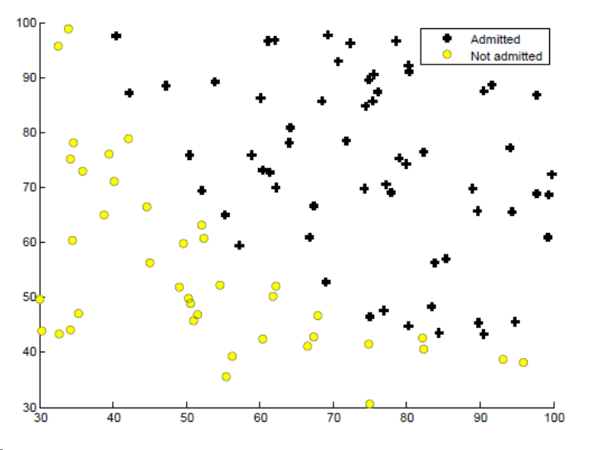

Exercise
Goldilocks and the 3 Tree Algorithms: the following plot shows data points with two scores, and the decision of whether or not each student was admitted to a program
Draw a decision boundary between admitted and not admitted points, which gives an example of:
Underfitting (too harsh)
Overfitting (too fitted)
Appropriate fit

Slide 25
Goldilocks and the 3 Tree Algorithms: the following plot shows data points with two scores, and the decision of whether or not each student was admitted to a program
Draw a decision boundary between admitted and not admitted points, which gives an example of:
Underfitting (too harsh)
Overfitting (too fitted)
Appropriate fit

Slide 26
Goldilocks and the 3 Tree Algorithms: the following plot shows data points with two scores, and the decision of whether or not each student was admitted to a program
Draw a decision boundary between admitted and not admitted points, which gives an example of:
Underfitting (too harsh)
Overfitting (too fitted)
Appropriate fit

Slide 27
Goldilocks and the 3 Tree Algorithms: the following plot shows data points with two scores, and the decision of whether or not each student was admitted to a program
Draw a decision boundary between admitted and not admitted points, which gives an example of:
Underfitting (too harsh)
Overfitting (too fitted)
Appropriate fit

Slide 28
How to find good fits?
Just like deciding best k for k-means clustering, we will use parameters for the decision tree to get best fit
EXERCISE
The plot shows accuracy of models trained with different values of a parameter p.
What is the best choice for parameter p? Where is overfitting occurring? Where is underfitting occurring?
accuracy
accuracy on training set
accuracy on testing set
1
p
10
Best choice is when p=7 since training & testing accuracy good ~70%
Overfitting when p=1-2 since training accuracy >> testing accuracy
Underfitting when p=8-10 since training & testing accuracy low

Slide 29
What is a good accuracy score?
Is 72% accuracy good?
accuracy
accuracy on training set
accuracy on testing set
1
Depends on the situation!
… if you are training a model to predict whether a tumor is benign or malignant?
… if you are training a model to predict the winner of a soccer game?
no
p
10
yes → $$$

Slide 30
Work Time
HW5 Q#2-3
Let’s get a start on some more homework questions. Grab a partner to get started.
View on our website

Slide 31
Machine Learning
With python
TREE3: tree-based algorithms
random forest, boosting, bagging
example workflow
Notes:
Layout objects pulled from: https://slidesgo.com/
All icons are from: https://thenounproject.com/

Slide 32
Colab workbook
Link: click for access

Slide 33
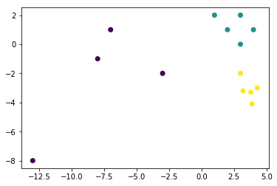
Exercise
The figure to the right has some clear clusters. Draw decision boundaries between the collection of points. Then color in each region for the class it belongs to.

Slide 34
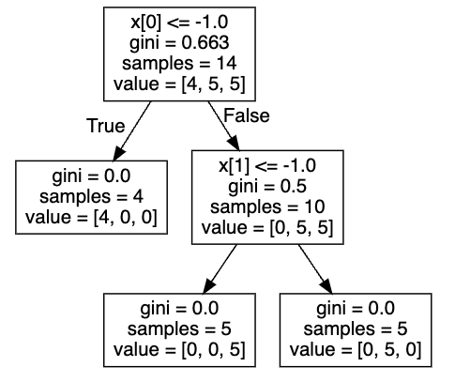
Let’s take a look at the decision tree for this data:
𝑋[0] is the 𝑥-coordinate, 𝑋[1] is the 𝑦-coordinate. The first split checks if the 𝑥-coordinate is less than or equal to −1.
The "gini" listed here is the gini impurity of the node. Notice that once we get to the bottom of the tree, the gini impurity is 0, since there is no uncertainty.
The "value" here tells us how many samples from each class follow the decision tree to that point. At the top, we have 14 total samples, with four from class 1, five from class 2, and five from class 3. If we follow the tree to the right, we have 10 samples remaining, with five from class 2 and five from class 3.
How well does your graph regions from before match with this?

Slide 35
Let’s take a look at the decision tree for this data:

Slide 36
Decision trees have great advantages over other algorithms
Interpretability: able to look at decisions the algorithm made tells us about the data
Fast: quick to build predictions
Low data processing: no rescaling, handle continuous and discrete features
However it’s not all good news
If small and interpretable, not as powerful
Decision Boundaries: can be ambiguous
If large, prone to overfitting

Slide 37
Recall, the bias-variance tradeoff and its relation to over- and under- fitting
Situation 1: A model with high variance learns the training data very well at the cost of generalization.
Situation 2: A model with high bias doesn’t learn the training very well.
Ideally, we’d have a model with no variance or bias, but this is not realistic. You typically have to strike a balance between the two.
Warm-up
Situation 1 is an example of _______-fitting
Situation 2 is an example of _______-fitting
Asking too many questions in a decision tree is an example of Situation __
Asking too few questions in a decision tree is an example of Situation __
over
under
1
2
Notes:
🍐 This is a Pear Deck Multiple Choice Slide. Your current options are: A: overfitting, B: underfitting,
🍐 To edit the type of question or choices, go back to the "Ask Students a Question" in the Pear Deck sidebar.

Slide 38
Decision trees are prone to overfitting
This can be mitigated by using a random forest classifier instead.
A random forest classifier:
builds many decision trees using random sampling from training data points and features
classifies data points by finding predicted classification from all decision trees, and taking the most common
Note: some good things about tree-based methods are that minimal data pre-processsing is needed as it can handle various distributions feature may take on and most correlated features

Slide 39
Beyond Singular Decision Trees
Ensemble models: combines many simple models to obtain singular and potentially powerful model
Simple models are called weak learners since individual predictive power may be limited
Bagging: reduces variance by randomly sampling dataset to create multiple training sets
Why use in decision trees: helpful when decision trees produced high variance (and low bias) models.
Solution: averaging observations over multiple models will reduce variance

Slide 40
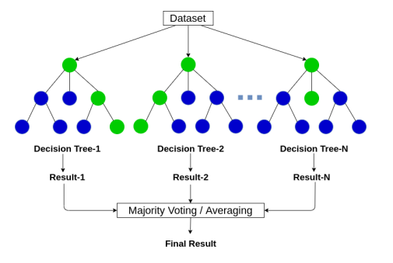
Random Forest
Bagging: reduces variance by randomly sampling dataset to create multiple training sets
Let’s take a look at the code in our workbook

Slide 41
Boosted Trees
Each new tree that is added now knows information from the tree that was built before it. It can correct errors of this previous trees using technique called gradient boosting
This process is similar to what is done in gradient descent in neural networks.
Thing to note: unlike regular RF, boosted trees CAN overfit. We can overcome this by regularization! A few parameters that you can tune are: max depth of tree, shrinkage rate, attribute ration, and the L1 and L2 loss coefficients.
sk-learn doc here
You’ll see how to tune some of these in PA5

Slide 42
Tree-based algorithms
Decision Trees: make decision rules on feature to make classification (categorical) or regression (numerical) predictions.
Pros: explainability, interpretability, missing data. Cons: overfitting, outliers.
Use cases: churn, disease prediction, credit modeling
Random Forest: ensemble method to combine multiple decision trees.
Pros: overfitting. Cons: training complexity, interpretability.
Use cases: credit modeling, housing price predictions
XGBoost: gradient boosting on feature to make classification (categorical) or regression (numerical) predictions which outperforms most other algorithms.
Pros: accurate results, non-linear relationships. Cons: complex hyperparameter tuning, sparse data.
Use cases: churn, insurance claims processing

Slide 43
Interpreting RF (or any ML algs)
Out-of-bag (OOB) error: Leave out one record and see what predictions the trees make on this left out record.
If OOB error close enough to testing error then good approximation
Feature Importance: see which features explain the most disorder in the data. This is just another way to see the decision tree in a tabular format.
sk-learn doc here
Partial Dependencies: see which feature contribute the most to your target variable. Can show relationship (linear vs non-linear) and interactions (what we call dependencies). Can also use ICE plots
sk-learn doc here

Slide 44
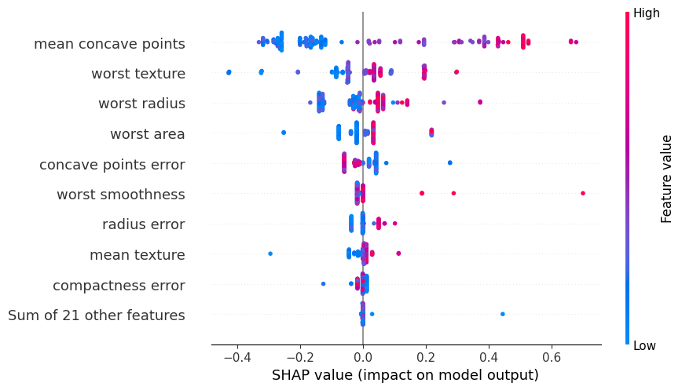
Interpreting model outputs using SHAP
Shapley values provide an estimate of how much any particular feature influences the model decision. When Shapley values are averaged they provide a measure of the overall influence of a feature
SHAP plot for target being 0 (malignant)
How to read:
order of features → importance
color → magnitude of feature values (range of that feature)
piles → lots of similar records
right of line → increase probability of predicting target == 0
left of line → decrease probability of predicting target == 0
predicting Benign
predicting Malignant

Slide 45
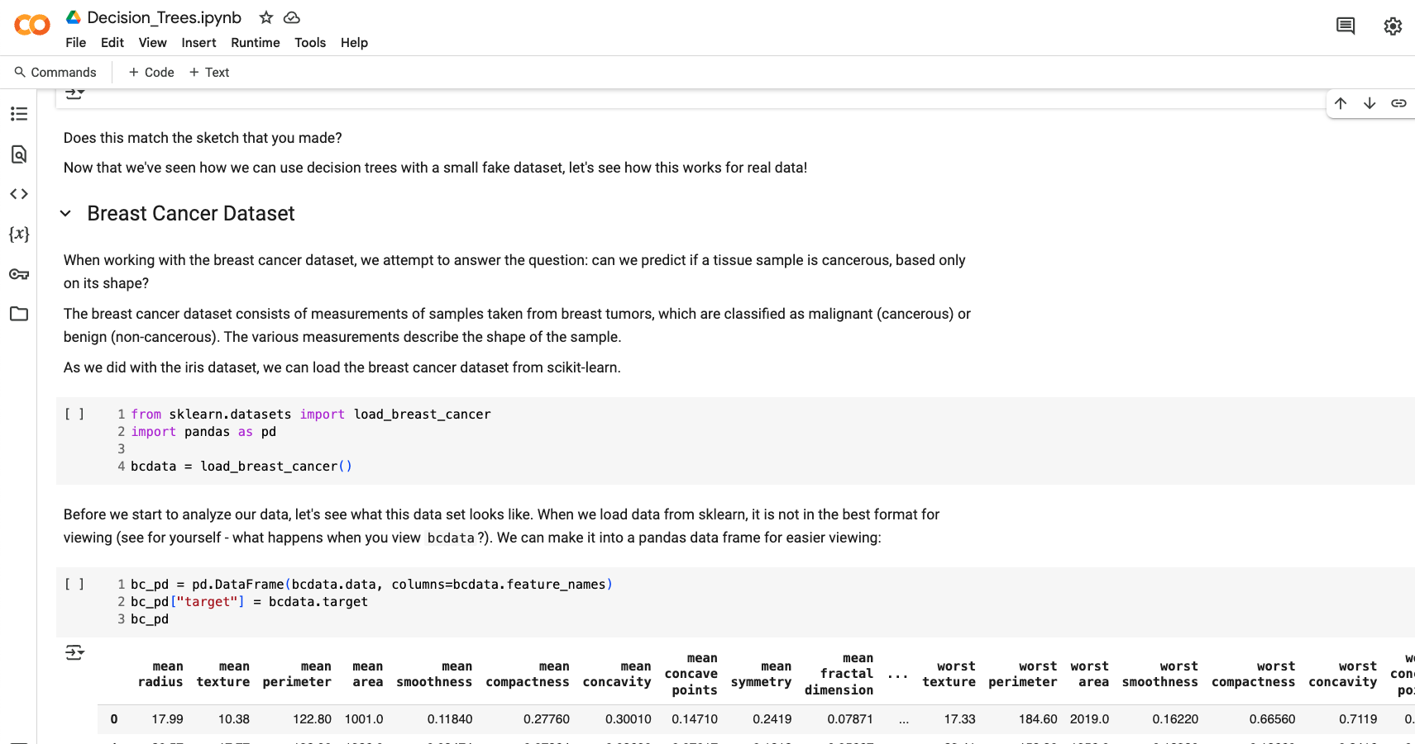
Workbook
Walk through the modeling done with the breast cancer dataset in the workbook.
Answer the questions related to accuracy and SHAP plots.

